Slide 1
Food{Hacker}
Domain Bucket: Green and Clean Technology
Category: Software
Organization: ICCE

Slide 2
Participants
Team Leader – Parth Bansal
Team Member – Aditya Rajput
Team Member – Deepanshu
Team Member – Aditya Kumar Yadav
Team Member – Nibir Maram Deka
Team Member – Neha Goyal

Slide 3
Introduction
A big portion of the waste material discarded is still in edible condition.
Basic idea behind the app is to log the user-bought items and efficiently recycle and redistribute the still eatable items to the less fortunate.
Technologies we used to develop the application:
Google Maps
DBMS
Sockets
Multithreading

Slide 4
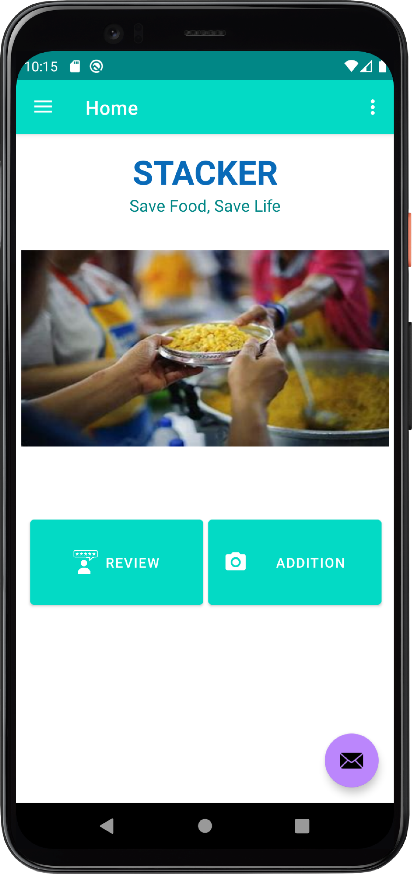
Home Screen
We have two buttons on the home screen.
Addition: If you click this button the camera is opened, and you can click pictures of the items you have bought from the market. The picture is then sent to our servers where it detects all the vegetables/fruits present and the date it will expire, taking the current season and temperature into consideration. You will also have the option to take a picture from the phone gallery.
Review: If you click this button A screen with the list view of all the additions can be viewed. It contains the vegetables/Fruits detected from the picture with their expiry details and quantity.

Slide 5
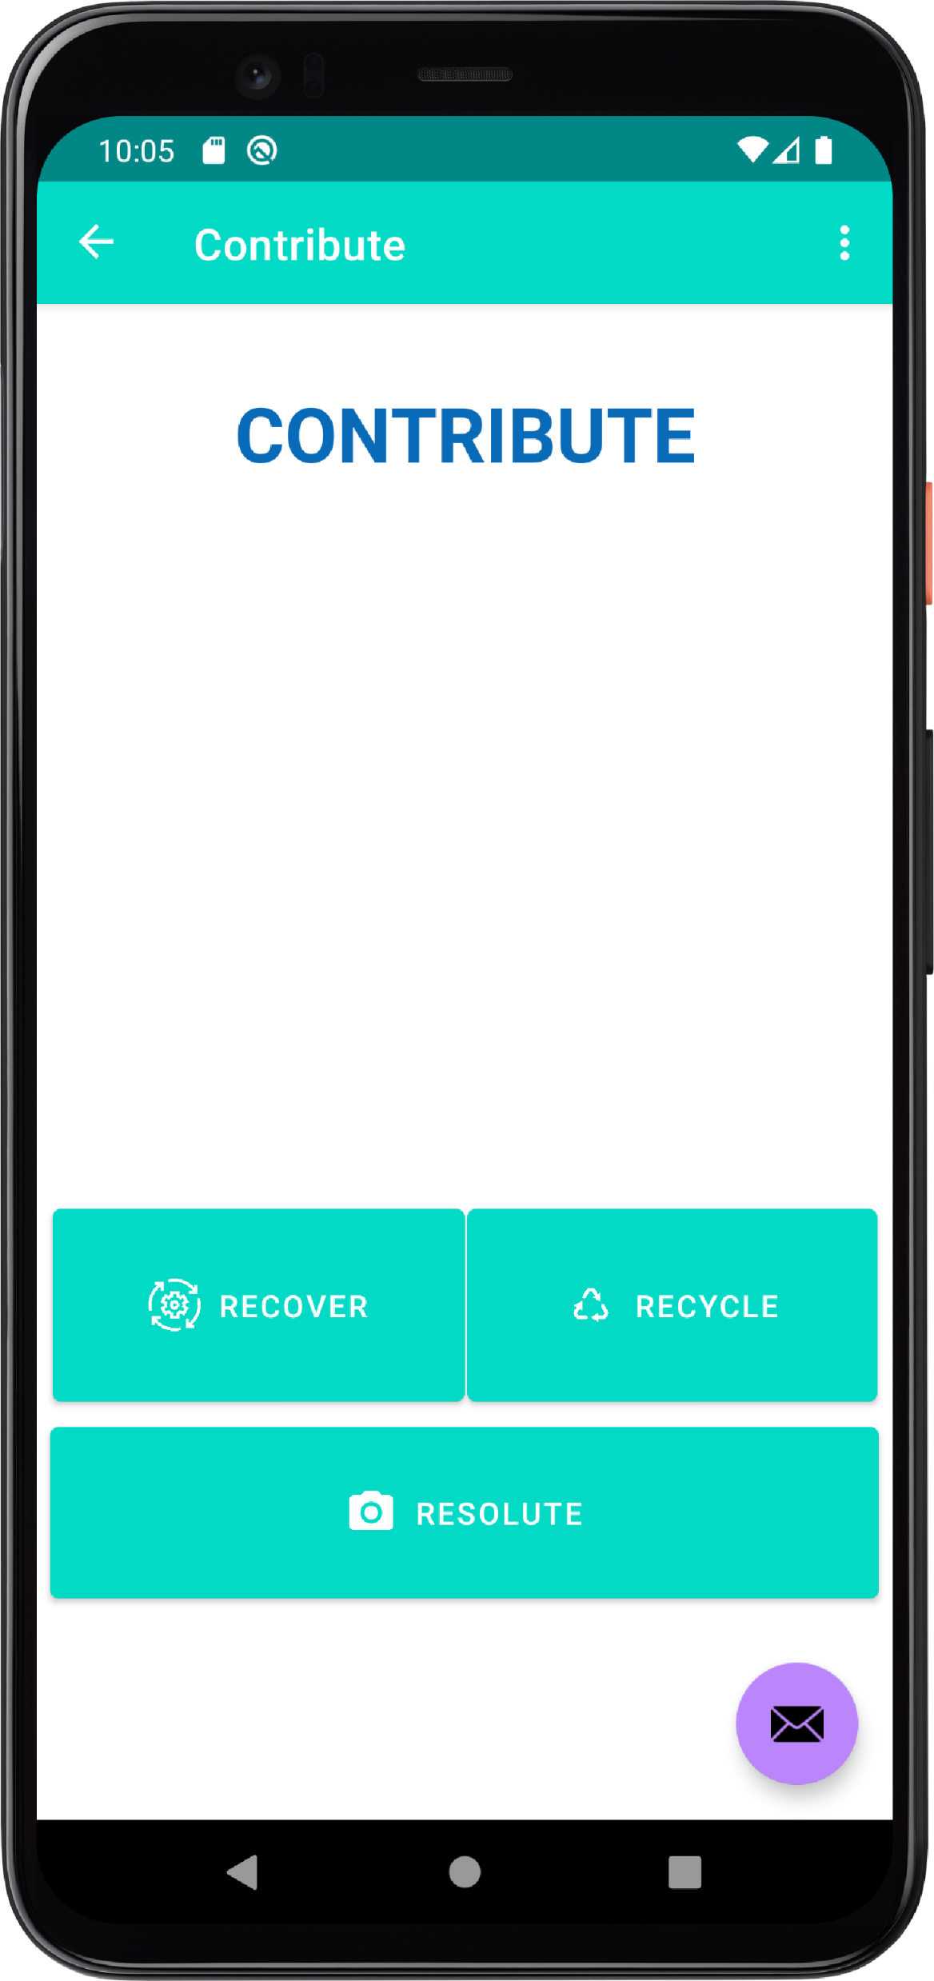
Contribute
When you click on this button, it directly opens the camera and you can click a picture with an option to confirm or re-take. After that, the picture with the location at which the picture is clicked is sent to our servers.
For the second step, our volunteers will go and pick up the leftovers/food from the location and they will decide if it will be reused (Still can be eaten) or recycled (can not be eaten). Users can also specify if the polled items are edible or not.

Slide 6

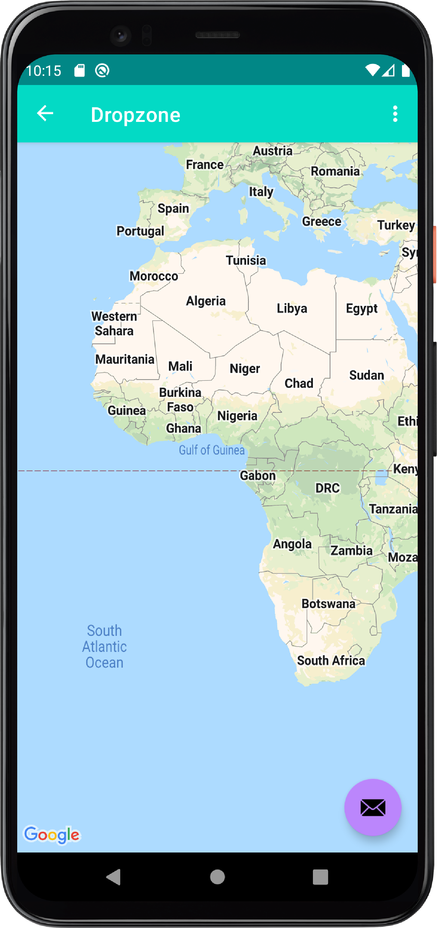

dropzone
When you click this button, a map will open and all the closest dropzones from your location can be viewed. You can deliver the leftover food items to the nearest dropzone.
For example, you are traveling, and you bought more food than you require, and you have no other option but to throw it what you can do is open Stacker and find the nearest dropzone and just handover the leftovers to us so no food is wasted.

Slide 7
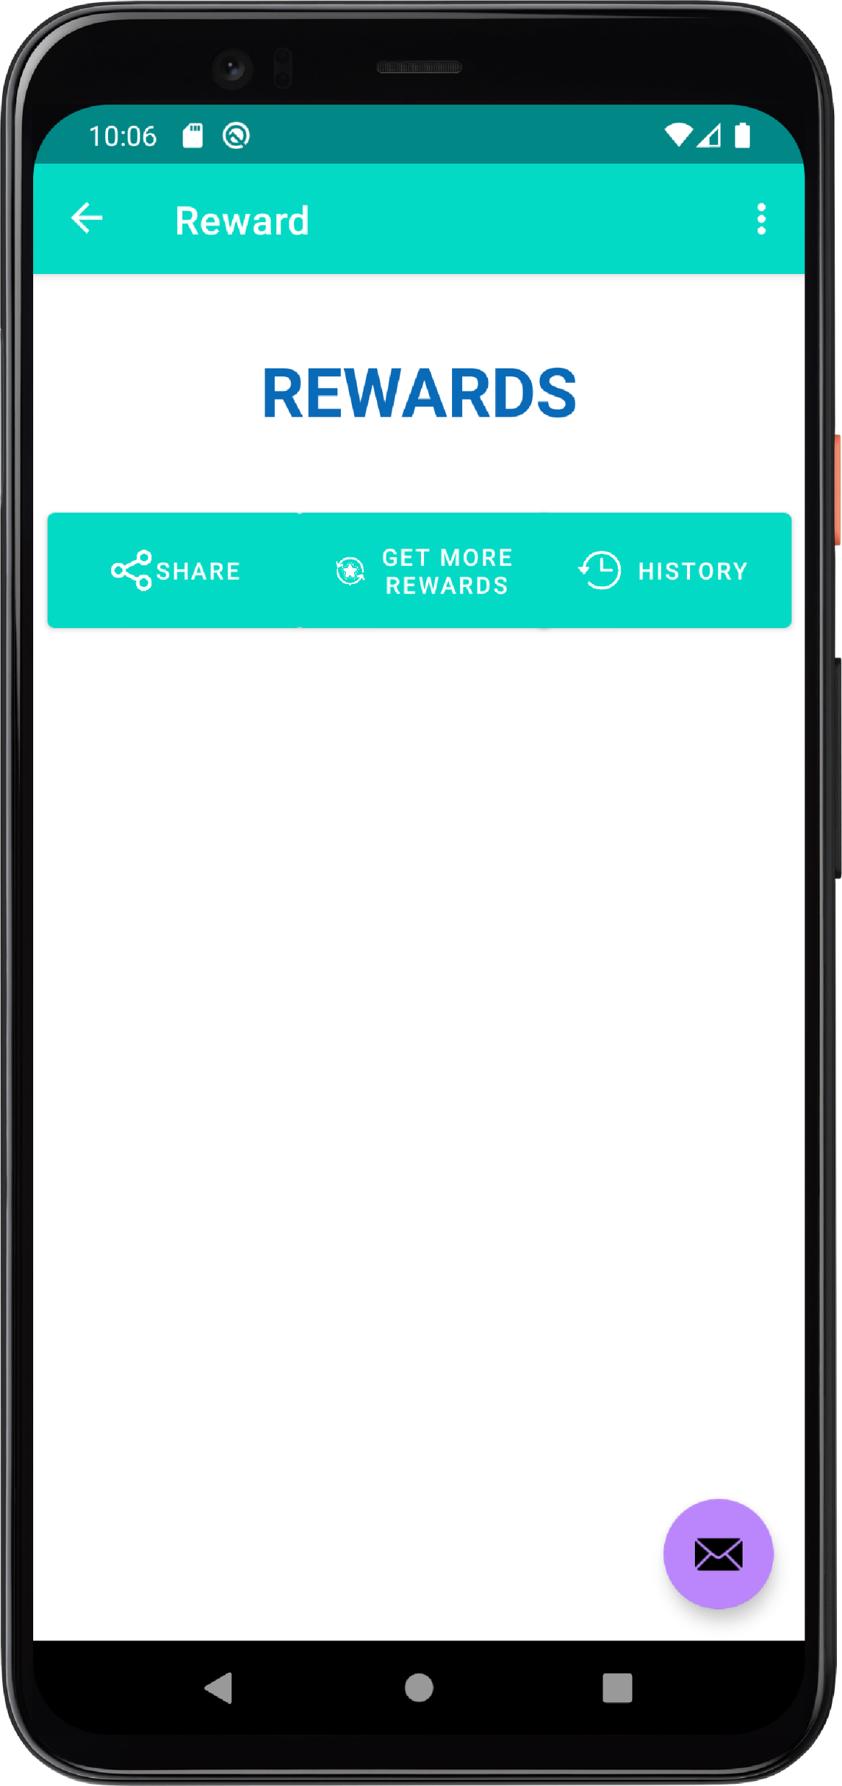
reward
It is like a normal reward system, the more you use Stacker and help us by volunteering or maybe just use Stacker to know about the expiry dates of the food you will receive badges.
These badges can be shared on social media to ‘flex’ how you are helping in this movement of saving food and giving back to society. (Which will also help in marketing of the app)

Slide 8
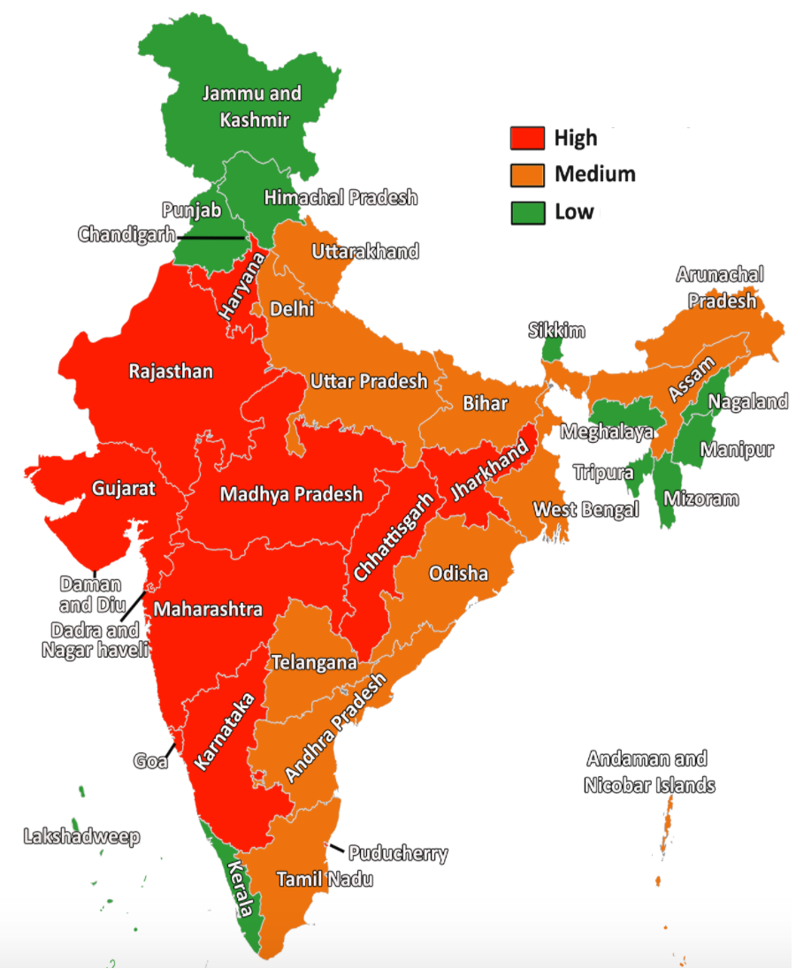
Goals
When you click this button, you can view all the goals or challenges which are region-wise (Delhi, Mumbai, etc.) to give them a sense of competition and give them another reason to use Stacker.
Goals can be like – 10K poll entries, 50 volunteers joined, etc.
When you complete the goals, you receive badges just like the rewards section mentioned before.

Slide 9
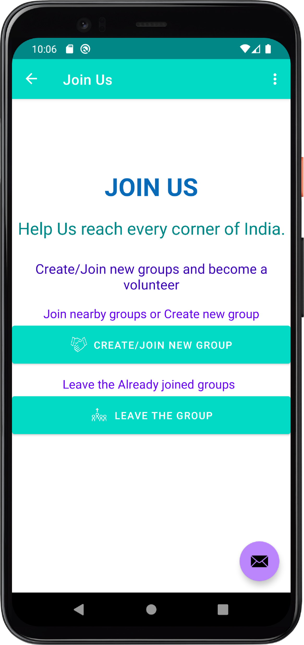
Join us
This section is used by the users who want to be volunteers and help us stop food wastage, by picking up the food leftovers and delivering them to the dropzones.
It will have the option to join and leave.

